Slide 1


Slide 2
Ribulose-1,5-bisphosphate carboxylase / oxygenase, commonly known by the abbreviation RuBisCO, is an enzyme involved in the first major step of carbon fixation, a process by which atmospheric carbon dioxide is converted by plants to energy-rich molecules such as glucose.
In chemical terms, it catalyzes the carboxylation of ribulose-1,5-bisphosphate (also known as RuBP).
It is probably the most abundant protein on Earth.

Slide 3
Rubisco is an important enzyme used to fix carbon during photosynthesis.
There are two stages in photosynthesis. Light dependent, and light independent. During Light dependent reactions, chlorophyll absorbs light and provides the electron to start the electron transport chain which eventually yields NADPH and ATP. The chlorophyll then regains the lost electron by taking one from water, producing oxygen as a product.
During light independent reactions, Rubisco takes up CO2 from the atmosphere and undergoes the Calvin Cycle to produce 3-carbon sugars used to make glucose.

Slide 4
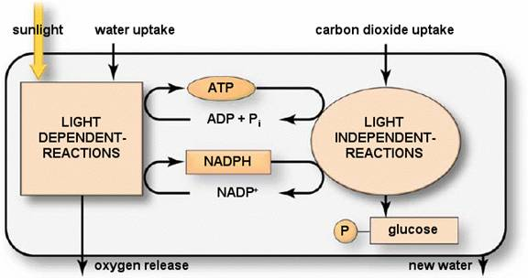
A summery of glucose synthesis in plants via the light dependent and like independent pathways

Slide 5
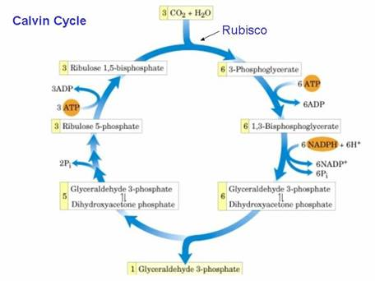
The calvin cycle, a glucose synthesis pathway in the light independent reactions in which Rubisco is a main participant

Slide 6
There are many reasons why Rubisco is model protein for isolating in lab.
First, because of its inefficiency as an enzyme, plants produce Rubisco in large amounts, making it relatively easy to isolate.
Secondly, it is found pretty much universally among many species, thus it can be treated the same way experimentally between species.
Thirdly, it is a very well studied protein thus there is much information known about the protein and its behavior in plants.

Slide 7
RuBisCo has a molecular weight of 490,000 Daltons and is composed of eight large subunits and eight small subunits.
The large subunits are coded in the chloroplast itself, while the small units are coded in the nucleus of the cell.
The term "RuBisCO" was coined humorously in 1979, by David Eisenberg.
The enzyme is located in the chloroplasts' stroma, consisting of at least 15% and up to 50% of the chloroplast protein. The high concentration of rubisco indicates a significant role for the plants metabolism.
It is estimated that 4 x 10¹³g of the enzyme is made every second.

Slide 8
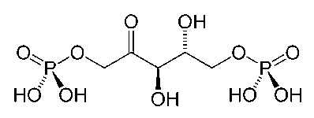

RuBP (ribulose 1,5-biphosphate) is a five-carbon sugar which reacts with CO2 in the first step of the Calvin cycle for fixing carbon in photosynthetic systems. That reaction is catalyzed by the large enzyme rubisco .
The catalytic reaction with RuBP and carbon dioxide through a short-lived intermediary almost instantaneously produces two molecules of glycerate 3-phosphate (3PGA).

Slide 9
In plants, algae, cyanobacteria, and phototrophic and chemoautotrophic proteobacteria, the enzyme usually consists of two types of protein subunit, called the large chain (L, about 55,000 Da) and the small chain (S, about 13,000 Da).
The large-chain gene (rbcL) is part of the chloroplast DNA molecule in plants.
There are typically several related small-chain genes in the nucleus of plant cells, and the small chains are imported to the stromal compartment of chloroplasts from the cytosol by crossing the outer chloroplast membrane.

Slide 10
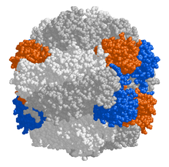
The enzymatically active substrate (ribulose 1,5-bisphosphate) binding sites are located in the large chains that form dimers as shown in Figure in which amino acids from each large chain contribute to the binding sites.
A total of eight large-chains (= 4 dimers) and eight small chains assemble into a larger complex of about 540,000 Da. In some proteobacteria and dinoflagellates, enzymes consisting of only large subunits have been found.
large chain dimers (white/grey)
small chains (blue and orange)

Slide 11
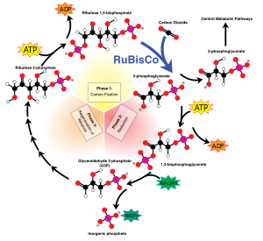

As shown in Figure, RuBisCO is one of many enzymes in the Calvin cycle.

Slide 12
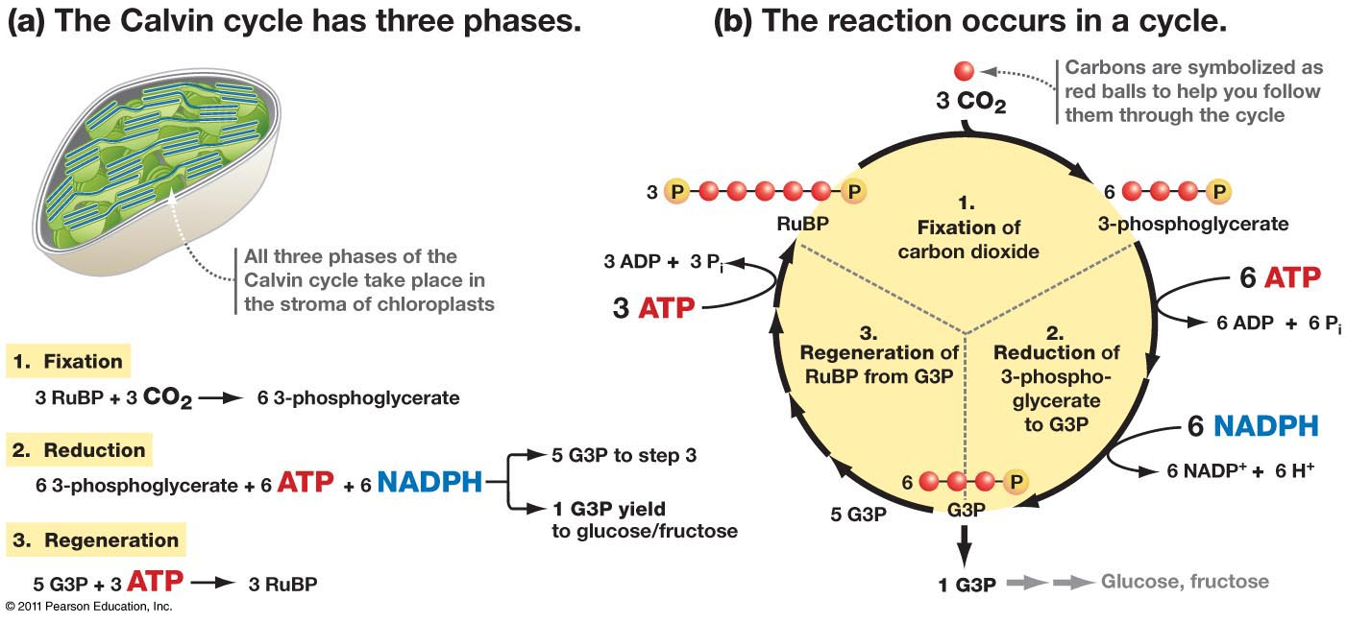

Slide 13
Substrates
During carbon fixation, the substrate molecules for RuBisCO are ribulose-1,5-bisphosphate, carbon dioxide .
RuBisCO also catalyses a reaction between ribulose-1,5-bisphosphate and molecular oxygen (O2) instead of carbon dioxide (CO₂).
Products
When carbon dioxide is the substrate, the product of the carboxylase reaction is a highly unstable six-carbon phosphorylated intermediate known as 3-keto-2-carboxyarabinitol-1,5-bisphosphate, which decays virtually instantaneously into two molecules of glycerate-3-phosphate.
The 3-phosphoglycerate can be used to produce larger molecules such as glucose. When molecular oxygen is the substrate, the products of the oxygenase reaction are phosphoglycolate and 3-phosphoglycerate.

Slide 14
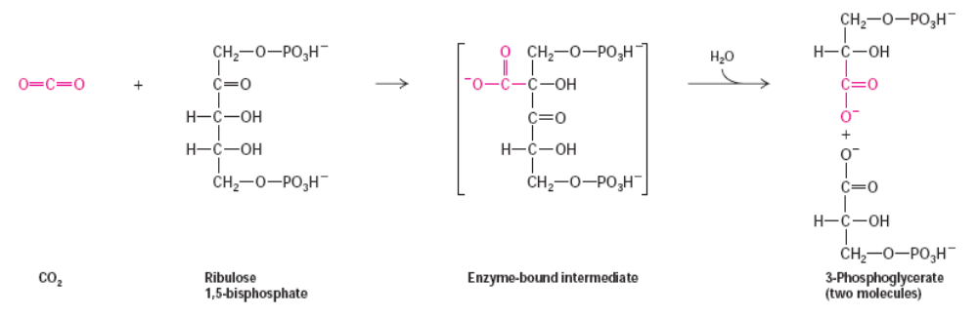
Three major stages of CO₂ fixation
Fixation stage: CO₂ is condensed to a five-carbon acceptor (ribulose-1,5-bisphosphate) to form 3-phosphoglycerate;
Reduction stage: 3-phosphoglycerate is reduced to glyceraldehyde-3-phosphate;
Regeneration stage: ribulose-1,5-bisphosphate is regenerated using glyceraldehyde-3-phosphate

Slide 15
Phosphoglycolate is recycled through a sequence of reactions called photorespiration, which involves enzymes and cytochromes located in the mitochondria and peroxisomes.
In this process, two molecules of phosphoglycolate are converted to one molecule of carbon dioxide and one molecule of 3-phosphoglycerate, which can reenter the Calvin cycle.
Some of the phosphoglycolate entering this pathway can be retained by plants to produce other molecules such as glycine.
At ambient levels of carbon dioxide and oxygen, the ratio of the reactions is about 4 to 1, which results in a net carbon dioxide fixation of only 3.5.
Thus, the inability of the enzyme to prevent the reaction with oxygen greatly reduces the photosynthetic capacity of many plants.

Slide 16

Some enzymes can carry out thousands of chemical reactions each second. However, RuBisCO is slow, being able to fix only 3-10 carbon dioxide molecules each second per molecule of enzyme. The reaction catalyzed by RuBisCO is, thus, the primary rate-limiting factor of the Calvin cycle during the day. Nevertheless, under most conditions, and when light is not otherwise limiting photosynthesis, the speed of RuBisCO responds positively to increasing carbon dioxide concentration.

